Slide 1

UE20CS390B Capstone Project Phase 2 END SEMESTER ASSESSMENT REVIEW
Detection of Deepfake Videos
Project Id: PW23_MHR_01
PRESENTED BY
Abbu Bucker Siddique PES1UG20CS617 Hithesh D Nayak PES1UG20CS646
Mohammed Anas Danish PES1UG20CS614 Thejas N U PES1UG20CS606
DEPARTMENT OF CSE PES UNIVERSITY
UNDER THE GUIDANCE OF
DR. MAMATHA.H.R
HOD & PROFESSOR,
DEPARTMENT OF CSE,
PES UNIVERSITY

Slide 2
Outline
Detection of Deepfake Videos
Abstract
Team Roles and Responsibilities.
Summary of Methodology / Approach (Capstone Phase - 1)
Design Description
Modules and Implementation Details
Project Demonstration and Walkthrough
Results and Discussion
Lessons Learnt
Conclusion and Future Work
References
Thejas_Danish_Abbu Bucker_Hithesh

Slide 3
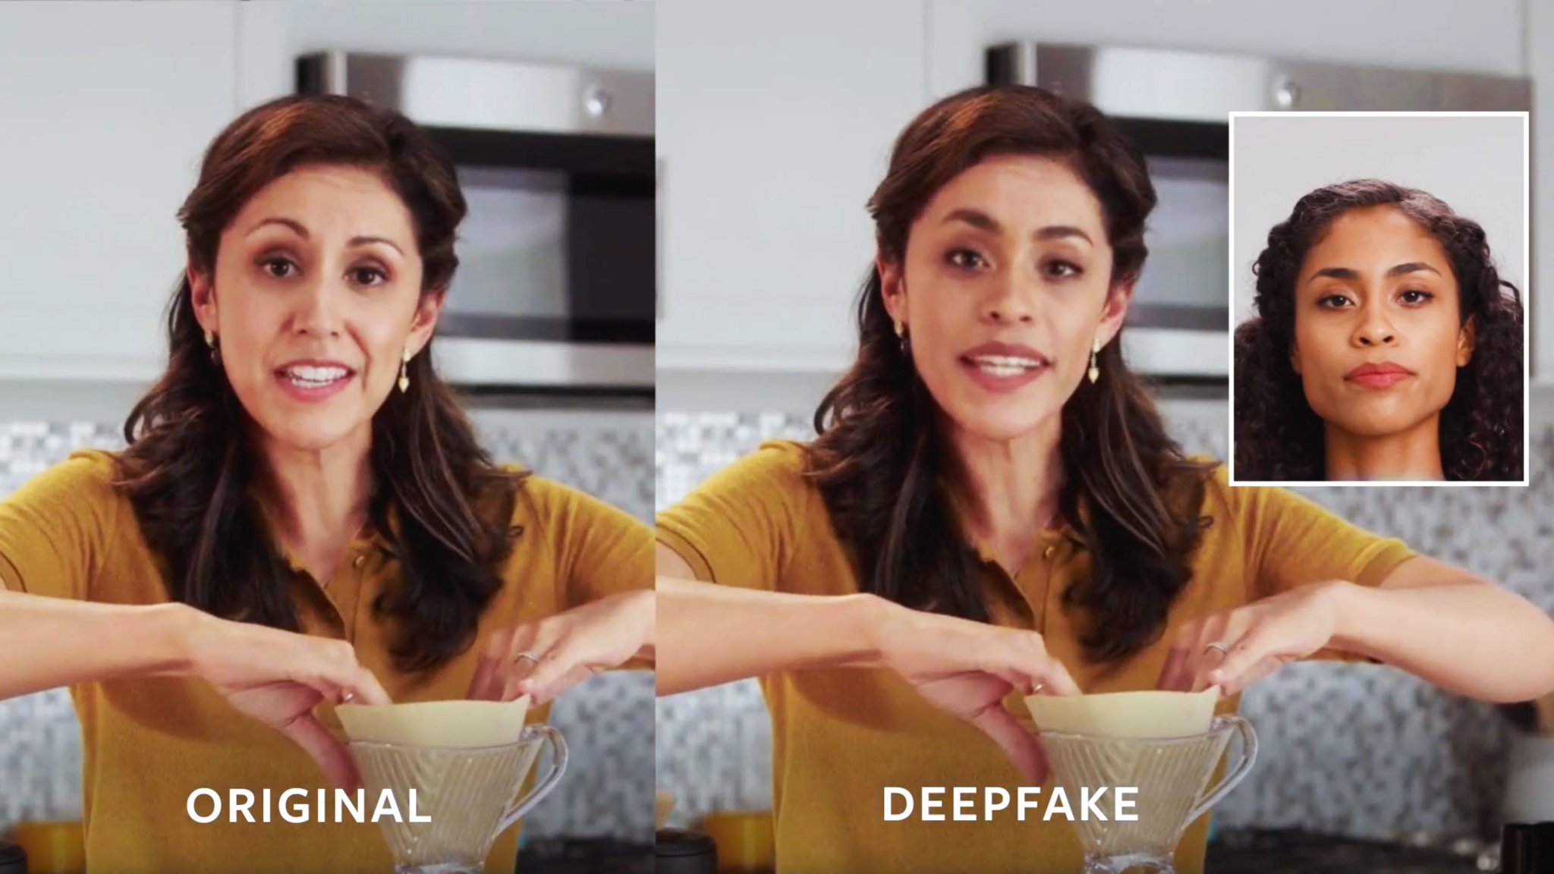
Abstract and scope
Detection of Deepfake Videos
What is a Deepfake?
Deepfakes are synthetic media which are digitally created to mimic/replicate another person
There are many types of deepfakes such as voice replications, face swapping, expression matching etc.
Our focus is towards detection of deepfake videos which are manipulated on visual part.
Thejas_Danish_Abbu Bucker_Hithesh

Slide 4
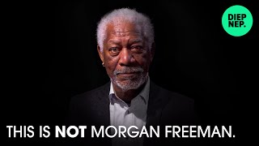
Deepfake Sample Video

Slide 5

Deepfake Sample Video

Slide 6
Abstract and scope
Detection of Deepfake Videos
What makes deepfakes harmful?
Spread of misinformation and fake news
Identity theft
Blackmail and extortion
Political manipulation
Defamation
Thejas_Danish_Abbu Bucker_Hithesh
Notes:
Disinformation and Fake News: Deepfakes can be used to create realistic-looking videos of public figures saying or doing things they never did. This can be exploited to spread false information, manipulate public opinion, or influence elections.
Identity Theft: Deepfake technology can be misused to impersonate individuals by creating fake videos or audio recordings that appear genuine. This could be used for malicious purposes, such as framing someone for actions they didn't commit.
Fraud and Scams: Criminals could use deepfake technology to create convincing audio or video messages impersonating someone in a position of authority, such as a CEO or government official, to trick employees or individuals into taking certain actions, like transferring money.
Political Manipulation: Deepfakes can be used to create misleading videos of political leaders, altering their statements or actions to create political chaos, damage reputations, or manipulate public sentiment.
Blackmail and Extortion: Deepfakes could be used for blackmail by creating fake compromising videos or audio recordings of individuals and threatening to release them unless certain demands are met.
Creating Fake Evidence: Deepfakes can generate realistic-looking evidence, such as videos or audio recordings, that could be used in legal proceedings to frame innocent individuals or discredit legitimate evidence.
Sabotaging Relationships: Deepfakes can be used to create fake videos or audio recordings in personal relationships, leading to misunderstandings, conflicts, or even the breakdown of relationships.
Security Threats: Deepfakes could be used to impersonate individuals for unauthorized access to secure facilities, systems, or data, posing a serious threat to security.
Manipulating Audio for Voice Phishing: Deepfake technology can be used to mimic someone's voice accurately, making it easier to carry out voice phishing attacks, where individuals are tricked into revealing sensitive information over the phone.
Cultural and Social Impact: Deepfakes that manipulate historical footage or iconic moments can distort our understanding of the past, impacting cultural and social narratives

Slide 7
Team Roles and Responsibilities - Phase I
Detection of Deepfake Videos
01
Thejas N U
Literature survey towards various deepfake generation techniques
Proposing architecture for the model.
Implementing pre-processing methods.
02
Mohammed Anas Danish
Literature survey to detect gaps in current deepfake detection methods.
Proposing architecture for the model.
Collecting relevant datasets.
03
Abbu Bucker Siddique
Literature survey towards deepfake detection techniques.
Proposing architecture for the model.
Testing already existing detection models.
04
Hithesh D Nayak
Literature survey towards various deepfake evasion techniques.
Proposing architecture for the model.
Research towards feature extraction.
Thejas_Danish_Abbu Bucker_Hithesh

Slide 8
Team Roles and Responsibilities - Phase II
Detection of Deepfake Videos
01
Thejas N U
Video-to-Frames Decomposer
Face extractor
Training LBP+Classifier
Training and fine tuning the combined feature extractors model
Making report
02
Mohammed Anas Danish
Data Pre Processor
Training SIFT+Classifier
Making report
03
Abbu Bucker Siddique
Analyzed performance of various feature extractors on SVM
Training HOG+Classifier
Writing Research paper
04
Hithesh D Nayak
Training Face Pose Estimator+Classifier
Finding feature extraction methods
Writing Research paper
Thejas_Danish_Abbu Bucker_Hithesh

Slide 9
Design Details - Requirements
Detection of Deepfake Videos
Hardware Requirements:
Medium performance GPU(Like Nvidia T4)
Good CPU (Intel i5 11th gen , Apple M1 and above)
OS Requirements:
OS should be capable of running Python 3.0.0 and above
Thejas_Danish_Abbu Bucker_Hithesh

Slide 10
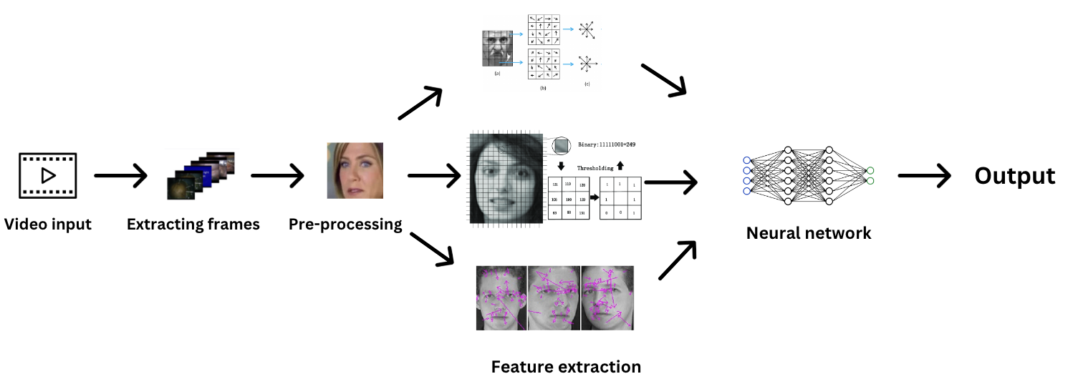
Design Details - Architecture
Detection of Deepfake Videos
Thejas_Danish_Abbu Bucker_Hithesh

Slide 11
List of Tasks/Modules
Detection of Deepfake Videos
Data Set Collection
Video-to-Frames Decomposer
Data-Preprocessor
Feature Extractor
Model
Chose 3 distinct datasets.
FaceForensics++, CelebDF, Kaggle
Converts videos into frames.
Optimizes frame count per video using techniques
Extracts face from each frame
Resizes, normalizes, converts to grayscale and processes images.
Enhances learning speed and result consistency.
Extracts face orientation features from images.
Utilizes these features in the classifier.
Creating a Deep Neural Network (DNN) which can do binary classification of images as real and fake.
Thejas_Danish_Abbu Bucker_Hithesh

Slide 12
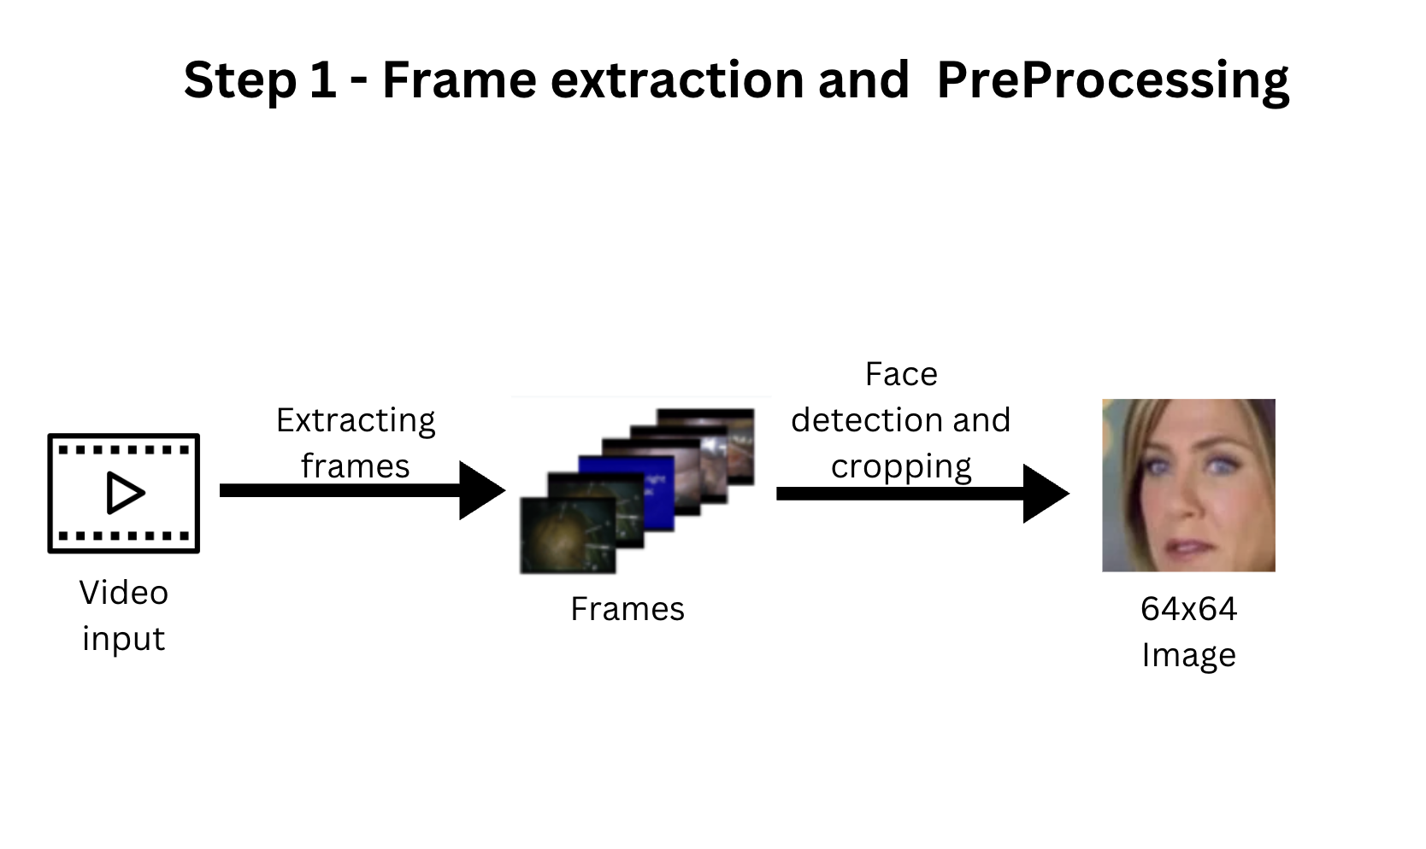
Architecture
Detection of Deepfake Videos
Thejas_Danish_Abbu Bucker_Hithesh

Slide 13
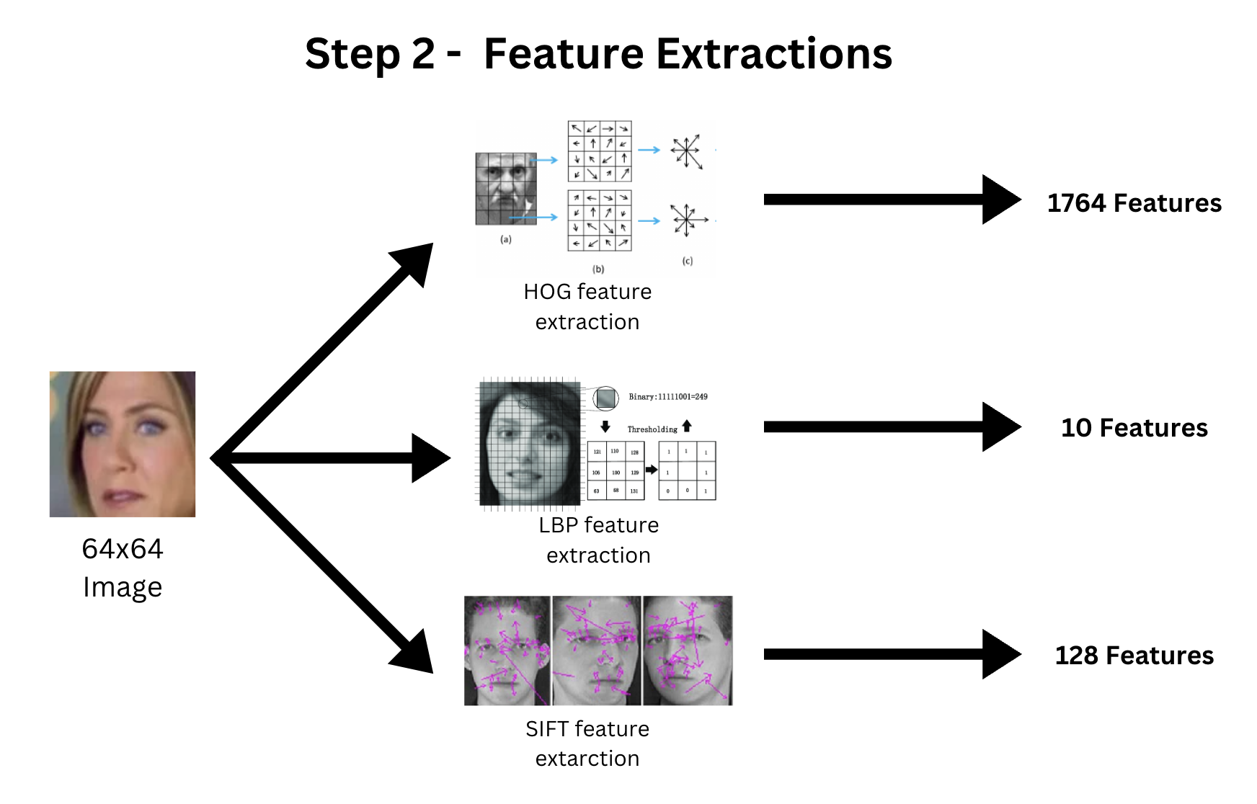
Architecture
Detection of Deepfake Videos
Thejas_Danish_Abbu Bucker_Hithesh

Slide 14
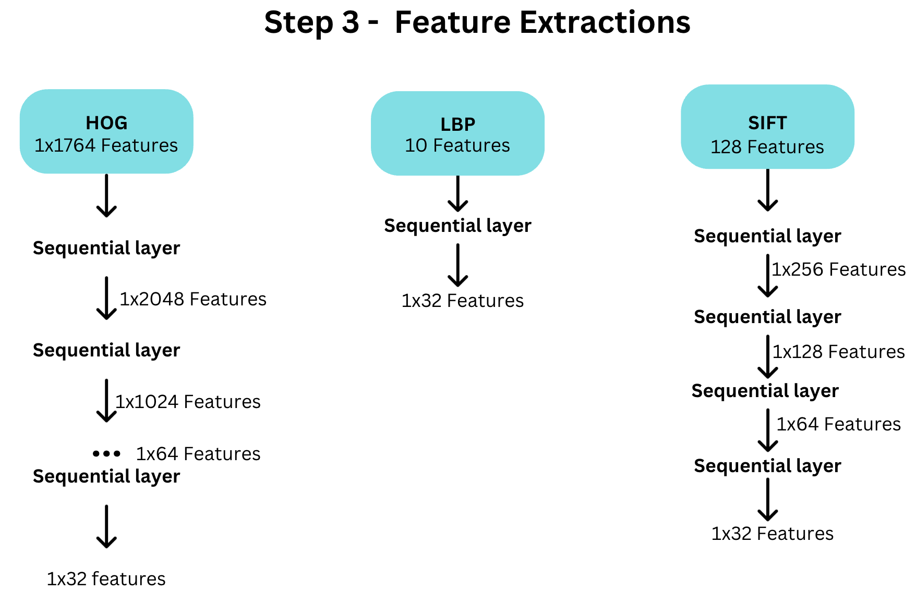
Architecture
Detection of Deepfake Videos
Thejas_Danish_Abbu Bucker_Hithesh

Slide 15
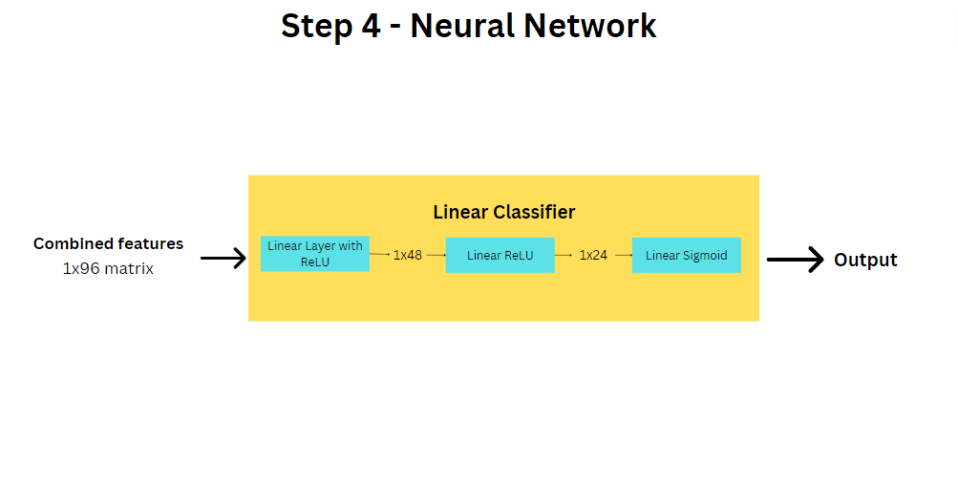
Architecture
Detection of Deepfake Videos
Thejas_Danish_Abbu Bucker_Hithesh

Slide 16
Proposed Approach/ Methodology
Detection of Deepfake Videos
Benefits of the new approach
Combination of different types of feature extraction will have evade evasion techniques
Will allow to be able to work with a wide range of data
Help increase model accuracy
Less training time and less bulky because of linear data and linear layers
Even though the approach leaves us with the above drawbacks, the proposed approach is still preferred. This is because:
Application of this technology does not require real time prediction.
We favour accuracy more than speed.
Thejas_Danish_Abbu Bucker_Hithesh

Slide 17
Project Demo and Walkthrough
Detection of Deepfake Videos
Code:
https://drive.google.com/file/d/1YagP-Y2btAUJhFGvbF0HYjy_sDiKOAIP/view?usp=sharing
Research paper draft:
https://www.overleaf.com/project/65223ec7a324640dcb129f44
Thejas_Danish_Abbu Bucker_Hithesh

Slide 18
Results and Discussions
Detection of Deepfake Videos
Architecture | Results
Images directly on CNN | ~62% Accuracy
Face Pose Estimator Features on NN | ~71% Accuracy
SIFT Features on NN | ~73% Accuracy
Local Binary Patterns Features on NN | ~75% Accuracy
HOG Features on NN | ~76% Accuracy
Preprocessed images directly on Resnet | test loss is ~45%
Combined architecture of images on Resnet and LBP data on NN | test loss is ~29%
Mesonet | needs 53.16GB GPU RAM to train 40,000 frames
SIFT+LBP+HOG on NN | ~96% accuracy and ~4% loss
Thejas_Danish_Abbu Bucker_Hithesh

Slide 19
Conclusion
Detection of Deepfake Videos
Successfully able to implement novelty feature.
On schedule for implementation and publication of research paper.
Existing models might perform well on particular kind of dataset, but when it comes to robustness they fail, since our model is trained on different datasets it works well on different evasion techniques.
Thejas_Danish_Abbu Bucker_Hithesh

Slide 20
Future Work
Detection of Deepfake Videos
Model can also be improved by adding more feature extractors.
Working towards building web app for testing of deepfake videos.
Testing on bigger datasets with more variety of deepfake detection techniques.
Improving model speed.
Thejas_Danish_Abbu Bucker_Hithesh

Slide 21
Lessons Learnt
Detection of Deepfake Videos
Training model with limited resources
Teamwork and collaboration
Research thinking
Fine tuning deep learning model
Avoiding drive timeout while preprocessing images
Thejas_Danish_Abbu Bucker_Hithesh

Slide 22






Technology used
Detection of Deepfake Videos
Thejas_Danish_Abbu Bucker_Hithesh

Slide 23
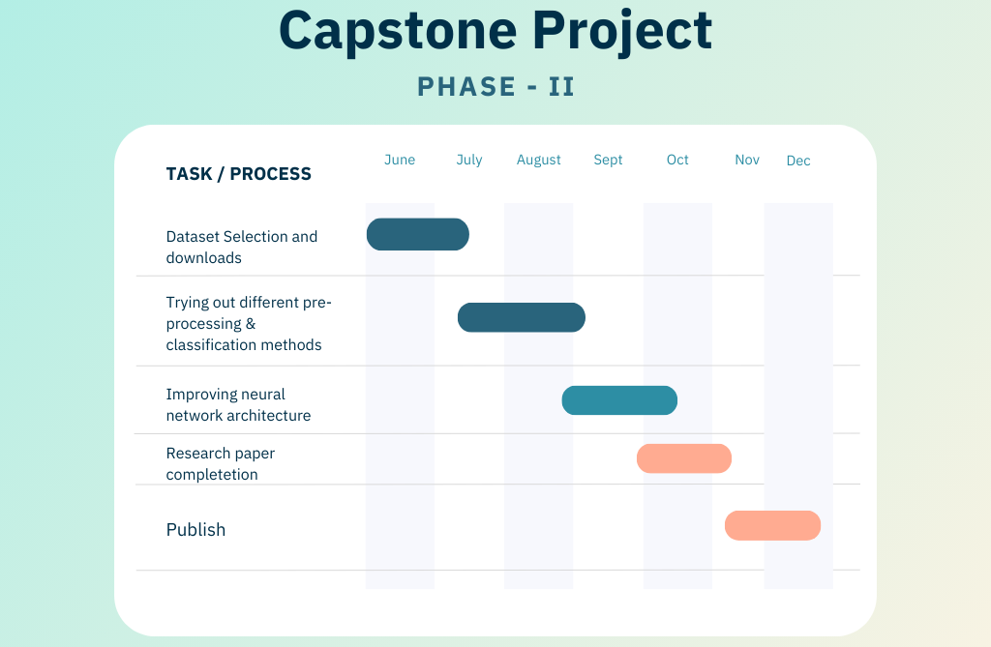
Detection of Deepfake Videos
Thejas_Danish_Abbu Bucker_Hithesh

Slide 24
List of Targeted Conferences
Detection of Deepfake Videos
IEEE IATMSI-2024: 2nd IEEE International conference on Interdisciplinary Approaches in Technology and Management for Social Innovation
AIMLA 2024: Second International Conference on Artificial Intelligence and Machine learning
ICOICC - 2023: 2nd International Conference on Innovative Strategies in Intelligent Computing and Communication
ETTIS-2024: 4th International Conference on “Emerging Trends and Technologies on Intelligent Systems
ICETDT-2024: International Conference on Emerging Trends in Digital Technologies-2024
ConvergenceX-2k24: ConvergenceX: Uniting the World Through IoT and AI Innovation
Thejas_Danish_Abbu Bucker_Hithesh

Slide 25
References
Detection of Deepfake Videos
[1] Mathews, Sherin, et al. "An explainable deepfake detection framework on a novel unconstrained dataset." Complex & Intelligent Systems (2023): 1-13.
[2] Patil, Kundan, et al. "Deepfake Detection using Biological Features: A Survey." arXiv preprint arXiv:2301.05819 (2023).
[3] Zhao, Hanqing, et al. "Multi-attentional deepfake detection." Proceedings of the IEEE/CVF conference on computer vision and pattern recognition. 2021.
[4] Wodajo, Deressa, and Solomon Atnafu. "Deepfake video detection using convolutional vision transformer." arXiv preprint arXiv:2102.11126 (2021).
[5] Zhang, Li, et al. "Unsupervised learning-based framework for deepfake video detection." IEEE Transactions on Multimedia (2022).
[6] Ikram, Sumaiya Thaseen, Shourya Chambial, and Dhruv Sood. "A Performance Enhancement of Deepfake Video Detection through the use of a Hybrid CNN Deep Learning Model." International journal of electrical and computer engineering systems 14.2 (2023): 169-178.
[7] Li, Xiaodan, et al. "Sharp multiple instance learning for deepfake video detection." Proceedings of the 28th ACM international conference on multimedia. 2020.
[8] Das, S., Seferbekov, S., Datta, A., Islam, M. and Amin, M., 2021. Towards solving the deepfake problem: An analysis on improving deepfake detection using dynamic face augmentation. In Proceedings of the IEEE/CVF International Conference on Computer Vision (pp. 3776-3785).
[9] Guarnera, L., Giudice, O. and Battiato, S., 2020. Fighting deepfake by exposing the convolutional traces on images. IEEE Access, 8, pp.165085-165098.
[10] Tan, Z., Yang, Z., Miao, C. and Guo, G., 2022. Transformer-based feature compensation and aggregation for deepfake detection. IEEE Signal Processing Letters, 29, pp.2183-2187.
[11] Coccomini, D.A., Messina, N., Gennaro, C. and Falchi, F., 2022, May. Combining efficientnet and vision transformers for video deepfake detection. In Image Analysis and Processing–ICIAP 2022: 21st International Conference, Lecce, Italy, May 23–27, 2022, Proceedings, Part III (pp. 219-229). Cham: Springer International Publishing.
Thejas_Danish_Abbu Bucker_Hithesh
Notes:
Misinformation: In 2020, a deepfake video of House Speaker Nancy Pelosi went viral on social media, making it appear as if she were slurring her words. This video was widely shared and viewed, leading to confusion and misinformation about Pelosi's health.
Privacy violations: In 2019, a deepfake video of actress Gal Gadot was released without her consent, which was used to create fake pornographic images and videos. This caused privacy violations and harassment towards the actress.
Damaged reputations: In 2018, a deepfake video of Facebook CEO Mark Zuckerberg was created and shared online, making it appear as if he were discussing Facebook's control over user data in a sinister manner. This video damaged Zuckerberg's reputation and raised concerns about deepfakes being used to manipulate public opinion.
Political manipulation: In 2019, a deepfake video of UK Foreign Secretary Jeremy Hunt was created and shared on social media, making it appear as if he were supporting Brexit in a speech. This deepfake video was created and shared by a pro-Brexit group with the intention of manipulating public opinion.
Legal issues: In 2019, Jordan Peele and Buzzfeed created a deepfake video of President Obama, which was used to raise awareness about the dangers of deepfakes. This video was created with Obama's consent, but creating and distributing deepfakes without consent can be illegal in certain jurisdictions.
Ethical concerns: Deepfakes have raised ethical concerns about technology being used to manipulate information and influence people's beliefs and actions. The ability to create highly realistic deepfakes has raised concerns about the potential for misuse in politics, media, and personal relationships.

Slide 26
References
Detection of Deepfake Videos
[12] V. -N. Tran, S. -G. Kwon, S. -H. Lee, H. -S. Le and K. -R. Kwon, "Generalization of Forgery Detection With Meta Deepfake Detection Model," in IEEE Access, vol. 11, pp. 535-546, 2023, doi: 10.1109/ACCESS.2022.3232290.
[13] W. Lu et al., "Detection of Deepfake Videos Using Long-Distance Attention," in IEEE Transactions on Neural Networks and Learning Systems, doi: 10.1109/TNNLS.2022.3233063.
[14] Y. Nirkin, L. Wolf, Y. Keller and T. Hassner, "DeepFake Detection Based on Discrepancies Between Faces and Their Context," in IEEE Transactions on Pattern Analysis and Machine Intelligence, vol. 44, no. 10, pp. 6111-6121, 1 Oct. 2022, doi: 10.1109/TPAMI.2021.3093446.
[15] H. A. Khalil and S. A. Maged, "Deepfakes Creation and Detection Using Deep Learning," 2021 International Mobile, Intelligent, and Ubiquitous Computing Conference (MIUCC), Cairo, Egypt, 2021, pp. 1-4, doi: 10.1109/MIUCC52538.2021.9447642.
[16] H. Chen, Y. Lin, B. Li and S. Tan, "Learning Features of Intra-consistency and Inter-diversity: Keys towards Generalizable Deepfake Detection," in IEEE Transactions on Circuits and Systems for Video Technology, 2022, doi: 10.1109/TCSVT.2022.3209336.
[17] C. R. Gerstner and H. Farid, "Detecting Real-Time Deep-Fake Videos Using Active Illumination," 2022 IEEE/CVF Conference on Computer Vision and Pattern Recognition Workshops (CVPRW), New Orleans, LA, USA, 2022, pp. 53-60, doi: 10.1109/CVPRW56347.2022.00015.
[18] J. John and B. V. Sherif, "Comparative Analysis on Different DeepFake Detection Methods and Semi Supervised GAN Architecture for DeepFake Detection," 2022 Sixth International Conference on I-SMAC (IoT in Social, Mobile, Analytics and Cloud) (I-SMAC), Dharan, Nepal, 2022, pp. 516-521, doi: 10.1109/I-SMAC55078.2022.9987265.
[19] A. Chintha et al., "Recurrent Convolutional Structures for Audio Spoof and Video Deepfake Detection," in IEEE Journal of Selected Topics in Signal Processing, vol. 14, no. 5, pp. 1024-1037, Aug. 2020, doi: 10.1109/JSTSP.2020.2999185.
[20] A. Rahman et al., "Short And Low Resolution Deepfake Video Detection Using CNN," 2022 IEEE 10th Region 10 Humanitarian Technology Conference (R10-HTC), Hyderabad, India, 2022, pp. 259-264, doi: 10.1109/R10-HTC54060.2022.9929719.
Thejas_Danish_Abbu Bucker_Hithesh
Notes:
Misinformation: In 2020, a deepfake video of House Speaker Nancy Pelosi went viral on social media, making it appear as if she were slurring her words. This video was widely shared and viewed, leading to confusion and misinformation about Pelosi's health.
Privacy violations: In 2019, a deepfake video of actress Gal Gadot was released without her consent, which was used to create fake pornographic images and videos. This caused privacy violations and harassment towards the actress.
Damaged reputations: In 2018, a deepfake video of Facebook CEO Mark Zuckerberg was created and shared online, making it appear as if he were discussing Facebook's control over user data in a sinister manner. This video damaged Zuckerberg's reputation and raised concerns about deepfakes being used to manipulate public opinion.
Political manipulation: In 2019, a deepfake video of UK Foreign Secretary Jeremy Hunt was created and shared on social media, making it appear as if he were supporting Brexit in a speech. This deepfake video was created and shared by a pro-Brexit group with the intention of manipulating public opinion.
Legal issues: In 2019, Jordan Peele and Buzzfeed created a deepfake video of President Obama, which was used to raise awareness about the dangers of deepfakes. This video was created with Obama's consent, but creating and distributing deepfakes without consent can be illegal in certain jurisdictions.
Ethical concerns: Deepfakes have raised ethical concerns about technology being used to manipulate information and influence people's beliefs and actions. The ability to create highly realistic deepfakes has raised concerns about the potential for misuse in politics, media, and personal relationships.

Slide 27

Detection of Deepfake Videos
Thejas_Danish_Abbu Bucker_Hithesh

